Slide 1
Advanced C++
Course Introduction, Random Topics and Random Review
Fall 2011
Kristina Shroyer

Slide 2
Agenda and Objectives
Introduction
  Syllabus/Course Introduction
  My Background
  Compilers
    Miscrosoft Visual C++ Express 2010
  MSDNAA
Reminder Slides on how to create projects in Visual C++ Express
Random Topics and Random Review
  Review: Standard Libraries (Chapter 6)
  Review: Random Number Generation (Chapter 6)
  New: Enumerated Types (Chapter 6)
  New (we did it but not in detail): Storage Classes (Chapter 6)
  Review (more detail): Scope Rules (Chapter 6)
  Behind the Scenes Function Call Process: The Function Call Stack and Activation Records (Chapter 6)
  Default function parameters
  You should also go back and review pass by reference and function overloading if you have forgotten since CSIS 135 or haven't taken C++ in a while
  Conditional Operator

Slide 3
IDE for this Class – Microsoft Visual C++
Why Microsoft Visual C++?
  While there are many good IDEs out there this is one that is used often in the real world, so whether you're a Microsoft fan or not, it's important to know how to use this tool
    If you have a Macintosh you should be able to get boot camp or another tool to be able to use this, everyone got this working last semester
    NO ONE should use Dev for this class under and circumstances (we will use a real IDE)
  It can be used to compile any C++ program that adheres to the ISO Standards
Minimum System requirements for the Visual C++ Express Edition Software
  Personal Computer with a Pentium III-Class processor, 600 mhz
  Microsoft Windows 2000 (with Service Pack 4), XP (with Service Pack 2), or Windows 2003 (with Service Pack 1)
  Internet Access
  Video: Recommended: 1024 x 768 High Color 16 bit
  Microsoft Mouse or compatible pointing device
If your computer at home does not meet the minimum system requirements or you are having trouble with Visual C++ Express Edition see me for another compiler option (we will have to find one (NOT DEV)!)
If you have a Macintosh I would like you to use Boot Camp or some similar software to run Windows and Microsoft Visual C++ on your Mac
  Mac's compiler is overbearing and doesn't adhere to ISO standards in the same way as Microsoft Visual C++ and has caused many problems for students in past classes, this is why I want you to use Boot Camp which has worked very successfully for Mac Students in the past
  I unfortunately do not yet have a Mac (only multiple PCs) but I will try to help students the best I can, if you have Boot Camp PLEASE raise your hand and help fellow Mac Students get this set up
  I found some Boot Camp help links on the Apple website I included in the syllabus to help people out

Slide 4
Large File Size Issue
In Microsoft Visual Studio 2010 Express the developers did something different that made all standard projects link to a large number of libraries and have a large number of external dependences
  They did this to try to make the program more convenient (and it may have been good for professional developers)
  For us, it caused a problem because it made project more than THREE TIMES as large as they used to be (even projects with only one .cpp file!!! – even when compressed they are too large)
  As a result I will not be able to keep all example programs in the instructor folder indefinitely like I usually do
What you need to do is:
  Copy the example programs EVERY class period (they may not be there the next class due to size)
  If you miss class or miss a set of examples try getting them from a friend or see me before/after class or during office hours and I can give them to you (I have them all on my portable hard drive)

Slide 5
Getting Visual C++ Express at Home
Make sure and get the 2010 version
  I can NOT open assignments done using old versions so I can't grade them
Note: The school has the professional version of Visual C++, however, the Express version is the free one everyone can get at home and is compatible with the Professional Version at School, so your programs will be compatible and you can transfer them back and forth between school and home

Slide 6
Getting Visual C++ Express at Home
IMPORTANT NOTE: EVERYONE should get the Express Version at home even if you plan on using MSDNAA to get the professional Version
  Do not wait for MSDNAA to get started
  I'm letting you do the first homework in groups just in case there are MSDNAA/Mac delays
Setting up Microsoft Visual C++ 2010 Express Edition at home (everyone should do this)
  Go to the website and download Microsoft Visual C++ Express Edition 2010
  http://www.microsoft.com/visualstudio/en-us/products/2010-editions/visual-cpp-express
    There is an "Install Now – English" button at the top of the page
    Do not install in a version other than English – I won't be able to help you with compiler errors if you do
  For the install/download
    Registration is FREE but required, just follow the instructions and register within 60 days
    We'll be creating Native Programs so you don't need to install the SQL server
    I would install the other features that are recommended and accept default options on the download

Slide 7
MSDNAA
MSDNAA is basically a program Microsoft has with the school (GCC) that allows students to get free Microsoft software through the school including the professional version of Microsoft Visual C++ 2010
  MSDNAA Info: http://msdnaa.glendale.edu/
  I have had A LOT problems with MSDNAA in the past so even if you want to get the free software still download Microsoft Visual C++ Express 2010 as was shown on the previous slide
  I have NO CONTROL over this program (so I DO NOT RUN MSDNAA – all I do is give your info to the person who runs it)
    All I do is get your name, student ID number and email address
    The MSDNAA program administrator then will send your Information to Microsoft and they will send you an email with directions on how to get the software
      THE EMAIL OFTEN GOES TO SPAM – CHECK YOUR SPAM, BECAUSE ONCE THEY SEND THE EMAIL IT IS NEXT TO IMPOSSIBLE TO GET A SECOND ONE
        The only thing that has worked in the past is sending a new request with another email, it is a HUGE hassle, so check spam and hopefully you will find the email
    I'll try my best to help you get the software but remember I have NO CONTROL
    IMPORTANT NOTE: If you have used MSDNAA in the past, your account will simply be re-activated and you will get no email, so use the same login as in the past
Problems questions on MSDNAA:
  If you checked your spam folder and did not receive an email send me another request with a different email and we'll try again
  The second option is to check the Frequently asked Questions/Support at the GCC Website: http://msdnaa.glendale.edu/
  If the above doesn't work contact the MSDNAA administrator at GCC:
    Name: Guillermo Rios
    Email: grios@glendale.edu
If you want MSDNAA it is REQUIRED you send me an EMAIL TONIGHT (right now even) – let's open the instructions in the instructor folder
  You must send the email by next week at the latest to get MSDNAA, after that it is too late
If you try for MSDNAA don't forget to download the Free Microsoft Visual C++ Express as shown on the previous slide also
  Do not count on MSDNAA and do not wait for it to start your programming assignments
  You should have the Express version installed by next week so you can start your first programming assignment next week

Slide 8
Running the Program using Visual C++
Using Microsoft Visual C++
  Projects and Solutions
    When you build programs in Visual C++ you work on a project and build a solution
    For the programs we will create, the C++ source code file(s) is/are located in the project folder
    The majority of C++ programs consist of many source code files rather than just one (at the beginning of the class we will use just one file to learn with)
      This is why the Visual C++ software requires the programmer to create a project and to add or create source code files into that project
        The IDE keeps track of the entire set of program files and the compile, link and run steps are also performed in the project environment
I'm going to review how to use the Microsoft Visual C++ 2010 Professional software to create a project, create a file into that project (we're going to create HelloWorld.cpp), and compile, link, and run the resulting program
  What I'm going to do right now is SLIGHTLY different than what is in the following slides so pay attention
    The following slides are for the Microsoft Visual C++ 2010 Express Version - you should use these when you install it at home this week, for right now follow what I'm doing on the screen
    You will need to know how to use both versions in order to participate in labs and do homework at home
Notes:
At first it may seem silly to have a project for one file but keep in mind more advanced C++ programs have multiple files….by the end of the class you will create a program with more than one file

Slide 9
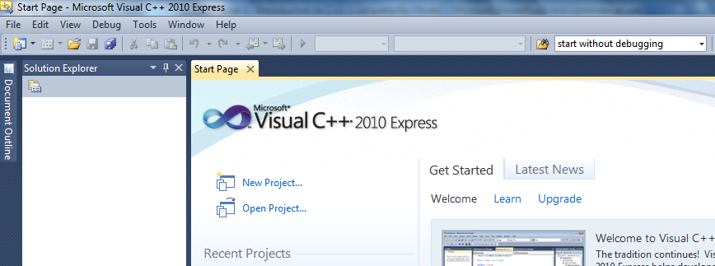
Running the Program using Visual C++
Using Microsoft Visual C++
  Step 1: From the start menu use the following path to start the program (you can also use the an icon on the toolbar or on the desktop)
    Start->All Programs->Microsoft Visual Studio 2010 Express->Microsoft Visual C++ 2010 Express Edition
    It may take a minute to load to start the first time you use it
Notes:
EVERYONE SHOULD FOLLOW ALONG AND GET YOUR OWN HelloWorld program running.
SO I'm going to do this process with the professional version…things are SLIGHTLY DIFFERENT…you need to listen in class (novel idea)

Slide 10
Running the Program using Visual C++
Using Microsoft Visual C++
  Step 2: Create a New Project
    In order to code and run the HelloWorld.cpp program it must be contained in a project
      A project must be set up before a program source code can be typed in (or added), compiled, and run
      The project will contain the source code (.cpp) files as well as any other files (like .h) files we need for the program
        For now our projects will just contain simple .cpp files
    To create a new project, use the File menu to select:
      File->New->Project
    You should see the New Project Window shown ON THE NEXT SLIDE
  NOTE: You only need to do this step ONCE FOR EACH PROJECT
  NOTE: SEE THE NEXT SLIDE….DO NOT USE THE CLR, You need to CHANGE the settings on this SCREEN!!!!!!! – DO NOT USE THE DEFAULT SETTINGS - CHANGE THESE TO THE SETTINGS SHOWN ON THE NEXT SLIDE!
Notes:
IMPORTANT SCREEN
HERE

Slide 11
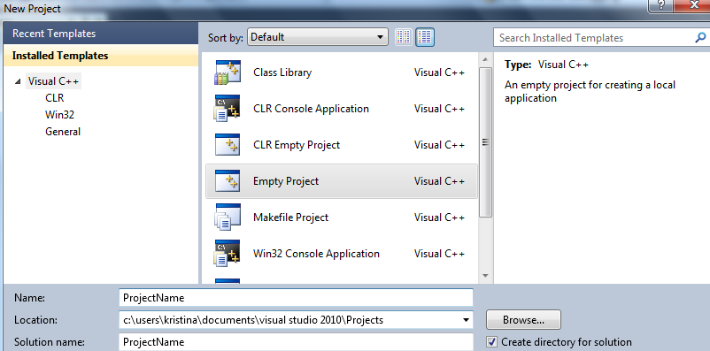
Running the Program using Visual C++
Using Microsoft Visual C++
  Step 2: Create a New Project (continued)
  In the New Project Window, select Empty Project in the right pane
  Next type in the name of your project, as you type in the name of your project it will be echoed in the Solution Name Field
  Finally, use BROWSE to change the location of your project
    Note Visual C++ has a default location, if you don't change it your project will be saved in that default location and you might lose it
  When you're finished select OK to continue
Notes:
DO NOT SELECT ANY OTHER PROJECT TYPE THEN GENERAL AND ALWAYS SELECT EMPTY – otherwise Visual C++ will add extra files to your project that you do not want…this will cause problems
PAY CLOSE ATTENTION TO THE LOCATION….if you don't Microsoft will save your project in a default location and you won't be able to find it….NOTE THE DEFAULT LOCATION

Slide 12
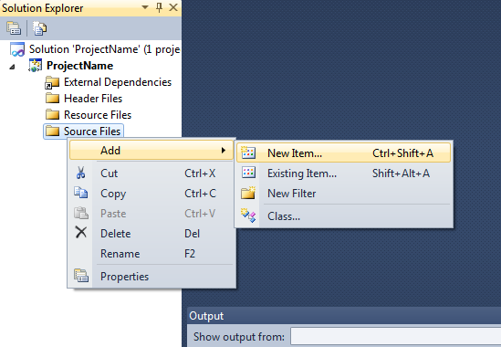
Running the Program using Visual C++
Using Microsoft Visual C++
Step 3: Create a New Source File (.cpp) and Type in Your Code
  When you finish these steps you will see your Visual C++ Solution. Note that there are folders for Header, Resource, and Source files in the window on the left
    Don't worry about Header or Resource folders for now
    To create a new source file, right click on the Source files folder in the solution window on the left of the screen
    You'll see a popup menu, from that menu select: Add: New Item
You always need to add at least one source file to your project!!
  Remember this is your C++ code that you will compile, link and run
  So this step always happens

Slide 13
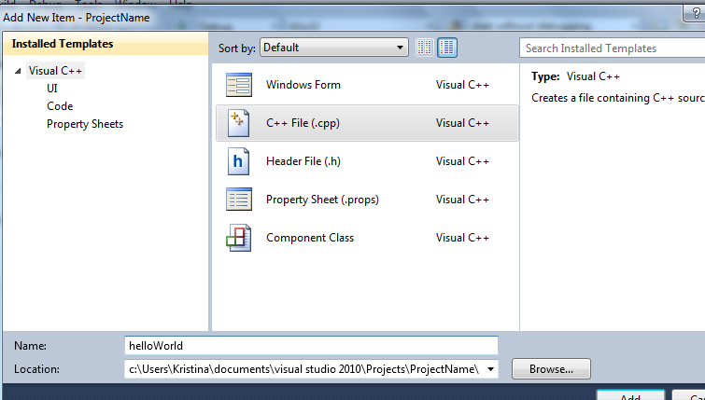
Running the Program using Visual C++
Using Microsoft Visual C++
Step 3: Create a New Source File and Type in Your Code (continued)
  In the Add New Item Window
    Select Code for the Category
    Select C++ File(.cpp) for the Template
    Type in the name of the file (In this case "HelloWorld.cpp")
    Select the Add Button
Make SURE AND SELECT THE RIGHT FILE TYPE
  You are creating a .cpp file, .cpp is the extension for a C++ file
Notes:
You must select the RIGHT FILE TYPE OR YOU WILL HAVE A PROBLEM

Slide 14
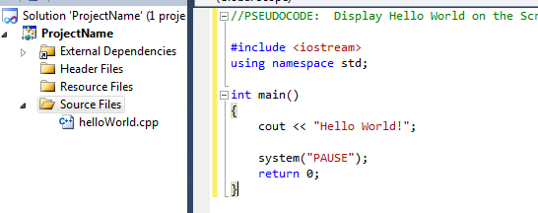
Running the Program using Visual C++
Using Microsoft Visual C++
Step 3: Create a New Source File and Type in Your Code (continued)
  Next, enter the source code for HelloWorld.cpp exactly as I have in the previous slides
    Type it in rather than copy and paste so you get used to the structure of a C++ Program (watch for syntax errors!)
    Make sure and save often
Notes:
TYPE THIS IN – DO NOT COPY AND PASTE

Slide 15
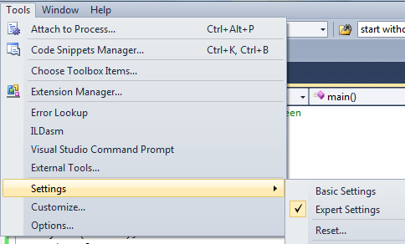
Running the Program using Visual C++
IMPORTANT!!! (New for Visual 2010)
Before you proceed make sure you have “Expert” Tool Settings
To do this select Tools->Settings->Expert Settings
Notes:
TYPE THIS IN – DO NOT COPY AND PASTE

Slide 16
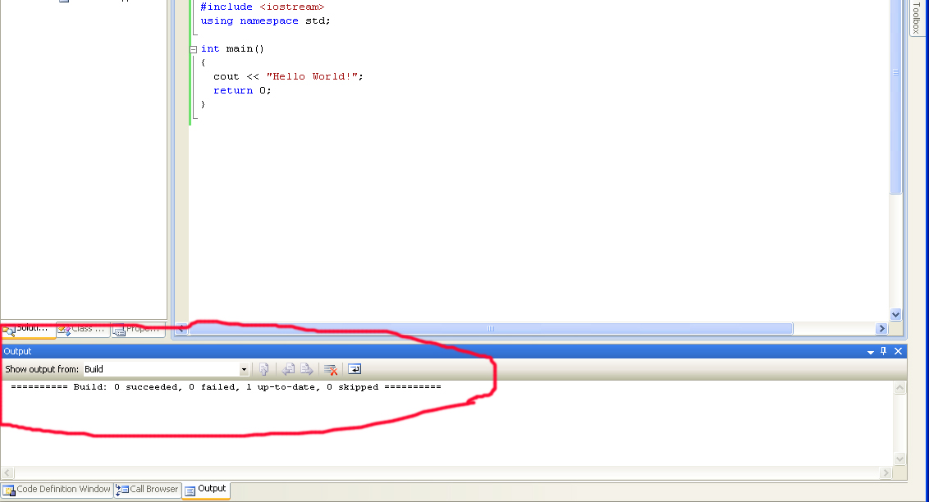
Running the Program using Visual C++
Using Microsoft Visual C++
Step 4: Compile your source code
  To compile go to the Build drop down menu and select Build Solution
    Build->Build Solution
    Successful Compilation (no errors is shown below)
  Any compilation errors are shown in the lower window
    (try making an intentional error and recompiling your code)
  NOTE: If you do have compilation errors double click on the line in the error window and Visual C++ will put the cursor on the line in the source code where it believes the problem exists
    HINT: Often the error is on the line before the compiler gives

Slide 17
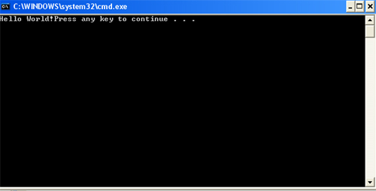
Running the Program using Visual C++
Using Microsoft Visual C++
Step 5: Run Your Program
  To run your program go to the Debug drop down menu and select Start Without Debugging
    Debug->Start Without Debugging
    Successful Compilation (no errors is shown below)
  Note the program displays this message at the end "Press any key to continue" – Press enter and close the window
    We'll learn how to put this on a separate line than "Hello World" in a few slides

Slide 18
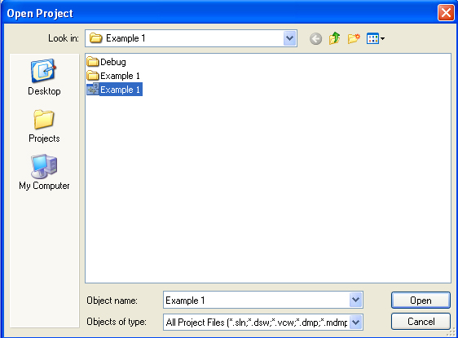
Running the Program using Visual C++
Using Microsoft Visual C++
Step 6: Close your project
  Make sure and select File->Save All before you close your solution
  Select File->Close Solution
How to Open a Saved Project
  Select File->Open Project Solution
    Browse to the place where you save your project
    Open the Solution File (.sln)
  DO NOT NAVIGATE TO THE C++ file and open that! Your project will appear to be open if you do this but it WILL NOT RUN

Slide 19
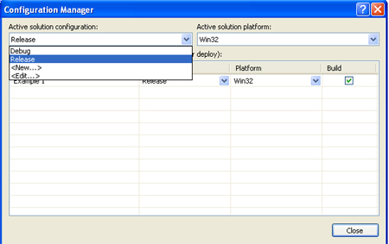
Running the Program using Visual C++
Using Microsoft Visual C++
Check out all the Files Visual C++ has set up for you
  You have a Debug folder and another Folder that contains your Hello.cpp file as well as additional files
    Don't worry about these additional files for now
  Note we compiled using the Debug configuration which caused Visual C++ to create a lot of extra files (necessary hooks for the debugger which we don't yet know how to use)
    This does make the program executable file fairly large
Once your program is working well you may select the configuration of Release which compiles and builds your program without the debugging hooks
  The projects we're doing are small so it's fine to just use the Debug configuration
  Below are the instructions for release mode if you are interested
  HOWEVER – MAKE SURE YOUR PROGRAM IS WORKING WELL FIRST
  To do this:
    Select: Build->Configuration Manager
    Using the Drop down menu, change the selection from Debug to Release
    Rebuild your solution:
      Build->Rebuild
      Now go look at the files generated
In the instructor folder
  I have many (not all, I should change them)
  of my Visual C++ projects in Release mode

Slide 20
Running the Program using Visual C++
Important Tips
  Warning 1: It is a BAD IDEA to close Visual C++ by pressing the 'X' button in the corner of the Window. Save your workspace and then close it.
    This ensures:
      Visual C++ is shut down properly
      ALL of your files and workspace are saved
      Everything can be located when Visual C++ is restarted
  Warning 2: When you start working on your project you must open the project/solution (.sln) file NOT the .cpp file.
      DO NOT DOUBLE CLICK YOUR .cpp file to begin working on a program

Slide 21
Turning in Homework/Projects
For this class I will collect homework and projects during class (during lab time at the BEGINNING of class)
I will collect the ENTIRE project folder
What you should do:
  Bring your homework/project folder (with everything in it) to school on your flash drive (you must have one for this class)
  Copy your homework/project folder (the entire thing) to your desktop
  I will come around during lab and collect

Slide 22
Review: C++ Standard Libraries
C++ Standard Library: This is part of the ISO ANSI Standard C++. It contains prepackaged functions and classes for common math calculations, string manipulations, character manipulations, input/output, error checking etc etc.
The standard library is divided into many sections, each section has its own header file
  The header files contain:
    function prototypes and related functions as well as definitions for various class data types and functions and the constants needed by those functions.
  A header file instructs the compiler on how your program should interface with the standard library and your user-written components that use those libraries
We want to use the ISO ANSI standard header files for our programs to be more portable
  Header files ending in .h are old style header files and we want to avoid using these, these old style header files have been superseded by C++ standard library header files
    you should be able to do all the programs in this class without resorting to old style headers (or other old style coding methods – NO GOTOS! NO GLOBALS except in certain situations) – we want to code in a modern portable way in here

Slide 23
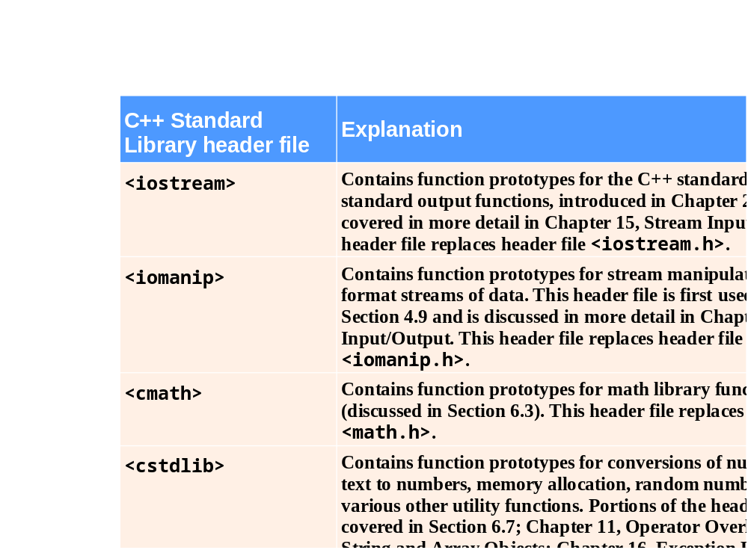
Review: C++ Standard Libraries
Fig. 6.7 | C++ Standard Library header files. (Part 1 of 4)

Slide 24
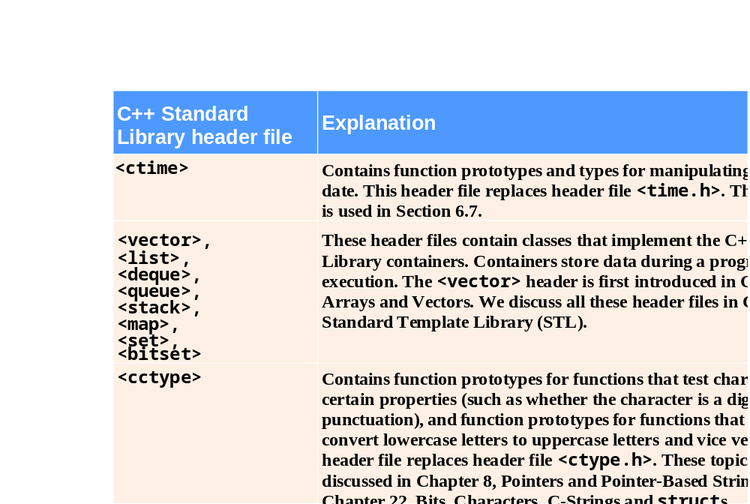
Review: C++ Standard Libraries
Fig. 6.7 | C++ Standard Library header files. (Part 2 of 4)

Slide 25
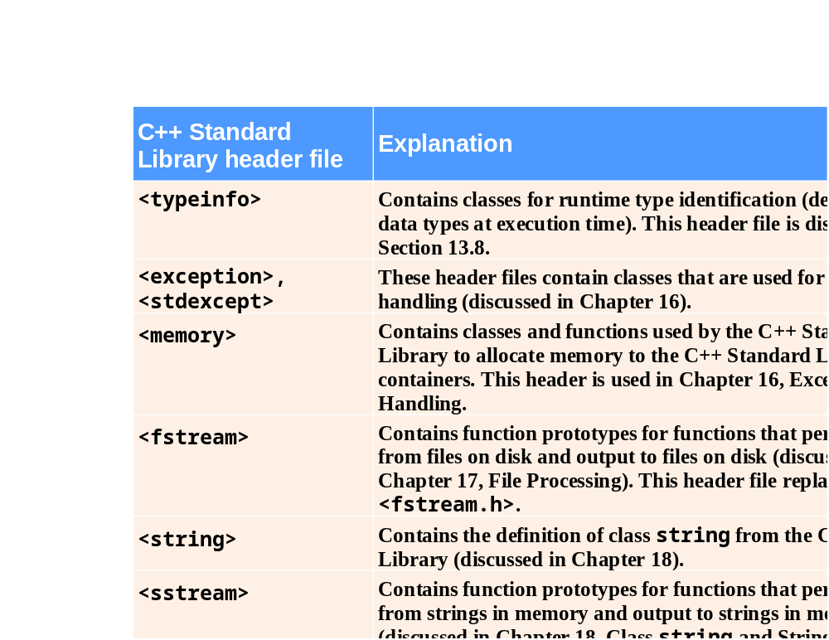
Review: C++ Standard Libraries
Fig. 6.7 | C++ Standard Library header files. (Part 3 of 4)

Slide 26
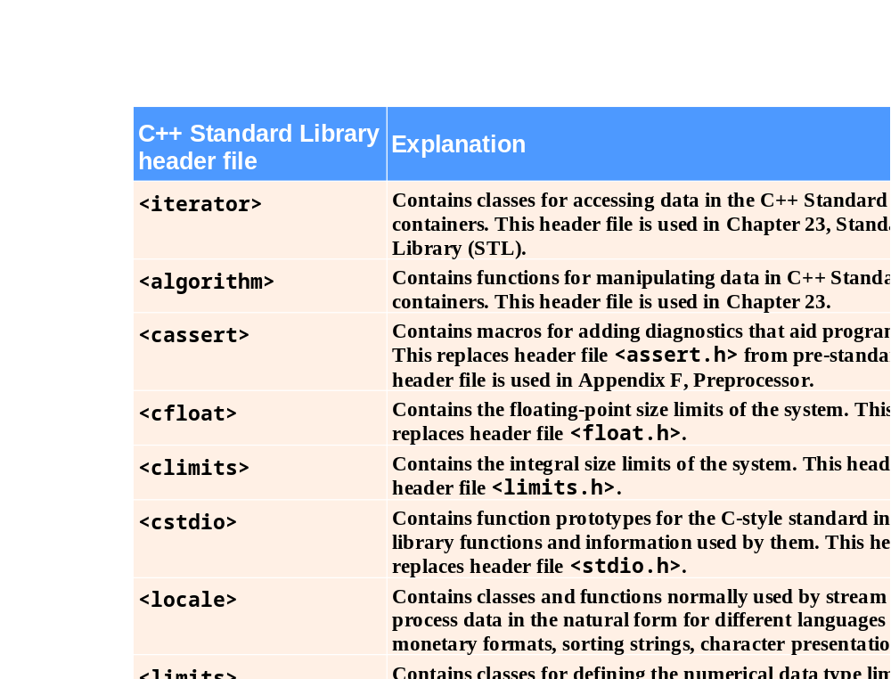
Review: C++ Standard Libraries
Fig. 6.7 | C++ Standard Library header files. (Part 4 of 4)

Slide 27
Review: Random Number Generation
C++ Standard Library function rand
  Introduces the element of chance into computer applications
  Example
    int i;
    i = rand();
      Generates an unsigned integer between 0 and RAND_MAX (a symbolic constant (named constant) defined in header file <cstdlib> )
      RAND_MAX is a constant defined in <cstdlib> . Its default value may vary but it is guaranteed to be at least 32767.
  Function prototype for the rand function is in <cstdlib>

Slide 28
Review: Random Number Generation
Most of the time you will want to generate a random number in a specified range you won't want to just rely on the value of RAND_MAX
You can do this using the % operator
  number = rand() % 100; //number is in the range 0 to 99
    The mod % operator returns the remainder of integer division. When the integer returned by rand() is divided by 100 the remainder will be a value between 0 and 99
  number = rand() % 100 + 1// is in the range 1 to 100
    Since the remainder of an integer divided by 100 is between 0 and 99 if we want the range of our random number to be between 1 and 100 we just need to add one to the remainder

Slide 29
Review: Random Number Generation
Function rand
  Generates pseudorandom numbers
  The same sequence of numbers repeats itself each time the program executes
Let's look at Example 1 – rand1.cpp
  You can find the Examples in the current lecture's example folder
  You can see when we run it we get the same sequence of 10 "random" numbers each time

Slide 30
Review: Random Number Generation
C++ Standard Library function srand
This function accepts an unsigned int as an argument and uses it to set the seed (starting value) for the rand function.
  If srand is not set each the rand function will produce the same sequence of numbers each time because the same starting number is being used in the algorithm generating the random sequence
  The most common way to use srand is as follows:
    srand (time(NULL));
    Here the argument to srand is a call to the time function with a NULL argument.
      The time function reads the computer's internal computer in seconds
      The srand function uses this time converted to an unsigned int to initialze the seed (starting value of the random number generator for rand()
  To use the time function in your program you will need to #include <ctime>
Function time (with the argument 0 or NULL)
  Returns the current time as the number of seconds since January 1, 1970 at midnight Greenwich Mean Time (GMT)
  Function prototype for time is in <ctime>

Slide 31
Review: Random Number Generation
Header Summary for random numbers
  You must #include <cstdlib> when using the random number functions
  To use system time you must also #include <ctime>
Let's look at Example 2 – rand2.cpp

Slide 32
Common Programming Error 6.7
Calling function srand more than once in a program restarts the pseudorandom number sequence and can affect the randomness of the numbers produced by rand.

Slide 33
Enumerated Data Types
An enumerated data type in C++ is a data type whose legal values are a set of named constant integers
  This is a special kind of programmer defined data type (it defines a set of data but is not a true data type in the object oriented sense because it does not define the actions that can be performed on that set of data)
Enumeration
  A set of integer constants represented by identifiers
    The values of enumeration constants start at 0, unless specified otherwise, and increment by 1
    The identifiers in an enum must be unique, but separate enumeration constants can have the same integer value
Example of an enumerated type declaration:
  enum Roster {Tom, Sharon, Bill, Teresa, John};
  Just as with structs/objects, this declaration does not create any variables, it just creates a data type. Basically this just defines a structure of what future variables we create of this data type will look like.
  Since I didn't specify differently Tom is represented by the integer 0, Sharon by 1, Bill by 2 and so on
Review question: What is the definition of a data type?

Slide 34
Enumerated Data Types
Our Enumerated type declaration (so this is a definition of an enum data type NOT a variable declaration)
  enum Roster {Tom, Sharon, Bill, Teresa, John};
Example of creating a variable of our enumerated type:
  Roster student;
  So the form of this statement is like any other variable declaration, this is a variable named student of type Roster
  Since student is a variable of the Roster data type we may store any of the values Tom, Sharon, Bill, Teresa or John in it
  Example assignment operation:
    student = Bill;
    The value of the variable could then be tested like so: if(student == Bill){ do something}
Important: Tom, Sharon, Bill, Teresa and John are named constants with integer values, NOT strings, in the example above Bill is NOT in double quotes like a string would be

Slide 35
Enumerated Data Types
Example so far:
  enum Roster {Tom, Sharon, Bill, Teresa, John};
  Roster student;
  student = Bill;
Back in CSIS 135 we said named constants are constant values that can be accessed by their symbolic names
  We just said that an enumerated data type in C++ is a data type whose legal values are a set of named constant integers
  So what is the value of Tom? Sharon? Bill? Teresa? John?
  If unspecified, the first symbol in the enum data type declaration has a value of 0, the second a value of 1, the third a value of 2 and so on
Even though the values of the enumerated type are stored as integers you can't always substitute the integer value for the symbolic name…so this would NOT work as a sub for the last line in the above example:
  student = 2; //BAD CODE
However you can TEST an enumerated value by using the integer value instead of the symbolic constant, the code below would be good:
  if(student == 2)
You can also use relational operators to test two enumerated values based on the integers they represent:
  student1 = John;
  student2 = Tom;
  if(student1 <= student2)

Slide 36
Enumerated Data Types
We said that by default, the symbols in the declaration of the enumerated type are assigned the integer values 0,1,2,3 etc in order
  However you can specify the values to be assigned
Example:
  enum Colors{red = 1, orange =4, yellow = 2, green = 5};
You can also partially specify the integer values, anything not assigned will be one more than the previous:
  Example: enum Months { JAN = 1, FEB, MAR, APR };
    Feb is 2, March is 3 and April is 4
  Example: enum Department{ factory, sales = 2, warehouse};
    factory is 0, warehouse is 3
CAUTION: Remember that if you do assign your own value to the enumerated symbols, you MUST use INTEGERS, no fractional values
One of the purposes of using an enumerated Data type is to make the program self documenting
  Just remember these symbols are NOT strings so they are for use inside the program only
  This code would output the number 1 NOT the word JAN
    enum Months { JAN = 1, FEB, MAR, APR };
    aMonth = JAN;
    cout << aMonth;

Slide 37
Enumerated Data Types
Example 3 – Roster.cpp
  This shows how you could use enums with a switch since they are associated with integer values
  Remember switch only works with integers and chars
  this program also shows you can use enums without creating any variables of the enum type
Example 4 – craps.cpp
  This one is taken from Chapter 6 of your book, the code is on the following pages
  For people like me that don't know the game of craps here are the rules (from the book):
    Craps is a game where the player rolls two dice (each dice has 6 sides and the numbers 1-6 as possible rolls). After the dice have finished rolling, the sum of what two dice land on (remember each can land on 1-6) is calculated by adding them together. If the sum is 7 or 11 on the first roll the player wins. If the sum is 2,3, or 12 on the first roll (called "craps") the player loses (so the house or casino wins). If the sum is 4,5,6,8,9 or 10 on the first roll the player must continue to roll until they get another roll equal to the first one (if they do that before rolling a 7 they win). If they roll a 7 before they get a roll equal to the first one they lose.
    So there are three states to the game: WIN, LOSE, CONTINUE – this is what the enumerated type will represent

Slide 38
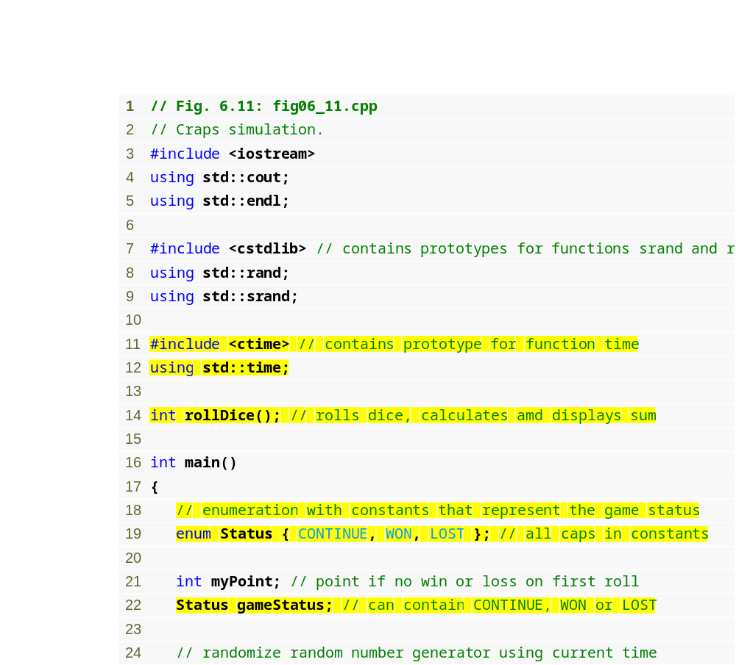
Example 4 – craps.cpp
(1 of 4)
#include and using for function time
Enumeration to keep track of the game status
Declaring a variable of the user-defined enumeration type
Seeding the random number generator with the current time
QUESTION: Why is the seed done here and not inside the function?
Notes:
Reminder on function prototype, what is it and what are the rules? Let's look at the function before the rest of main
In this class of course we would make this into an object oriented program

Slide 39
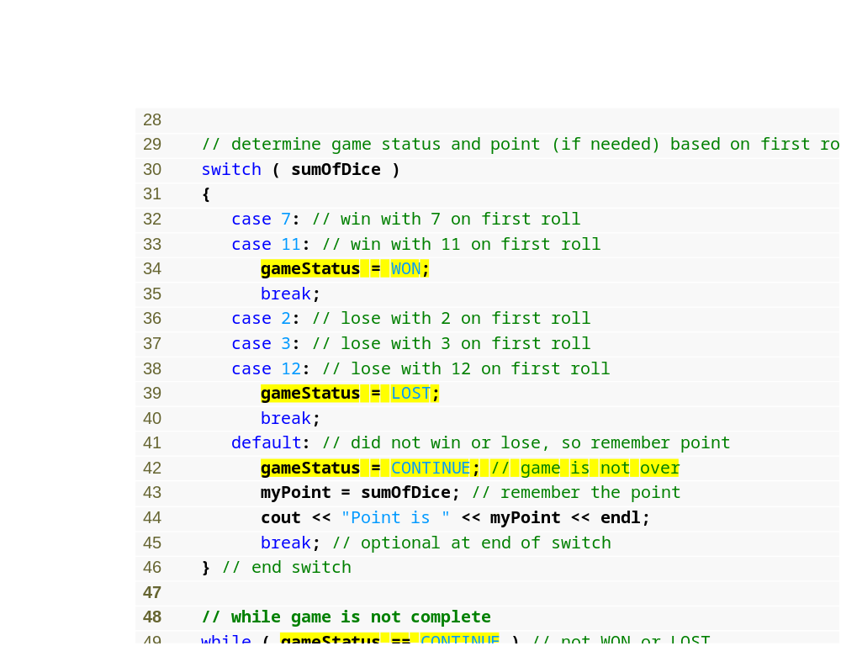
Example 4 – craps.cpp
(2 of 4)
Assigning an enumeration constant to gameStatus
Comparing a variable of an enumeration type to an enumeration constant

Slide 40
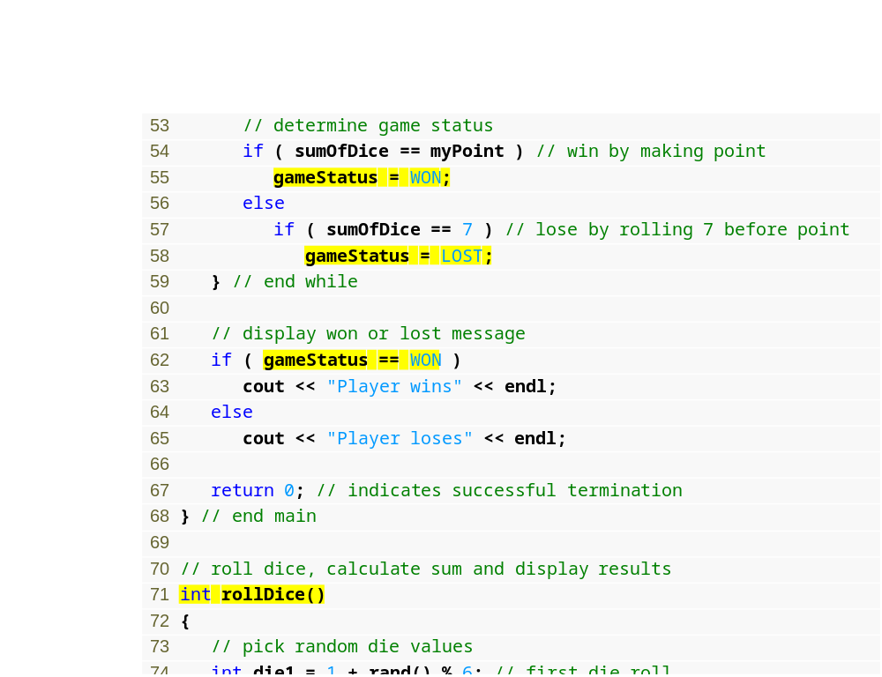
Example 4 – craps.cpp
(3 of 4)
Function that performs the task of rolling the dice

Slide 41
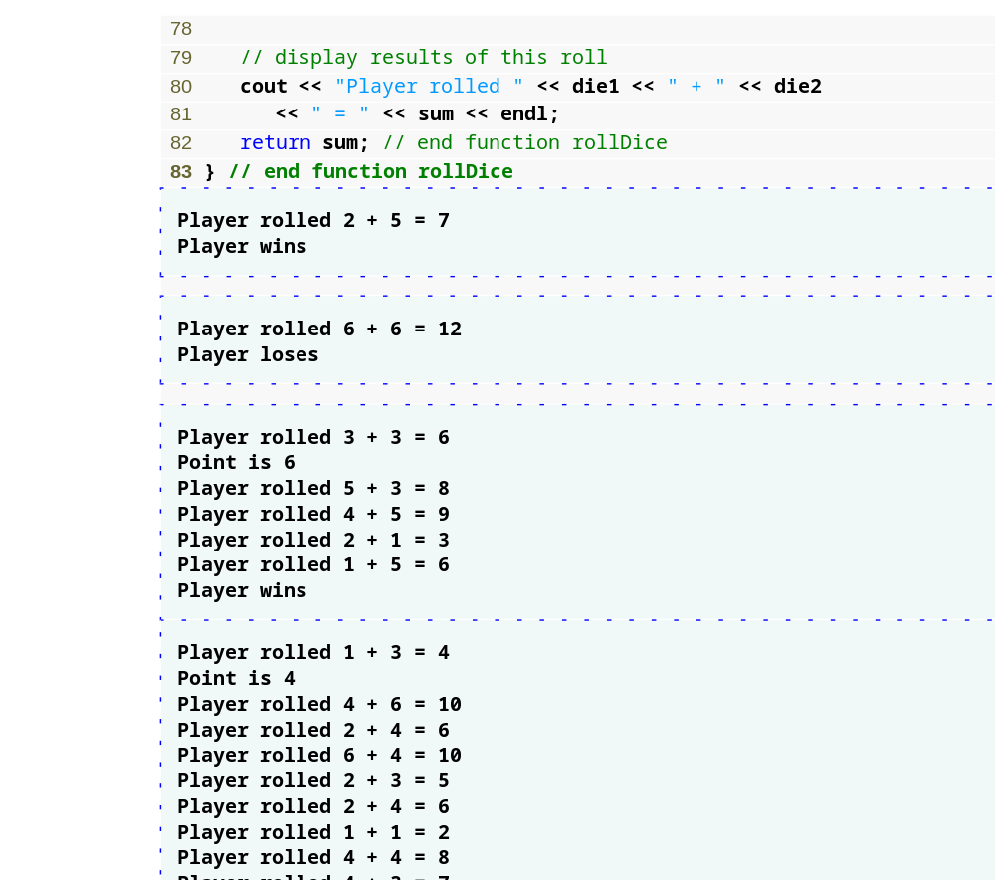
Example 4 – craps.cpp
(4 of 4)

Slide 42
Enumerated Data Types
Thinking ahead, if you were going to make the craps game object oriented (since we'll be doing object oriented programs in this class), what would your data type definition look like?
  What member variables would you have?
  What member functions would you have?

Slide 43
Good Programming Practice 6.1
Capitalize the first letter of an identifier used as a user-defined type name.

Slide 44
Good Programming Practice 6.2
Use only uppercase letters in the names of enumeration constants. This makes these con­stants stand out in a program and reminds the programmer that enumeration constants are not variables.

Slide 45
Good Programming Practice 6.3
Using enumerations rather than integer constants can make programs clearer and more maintainable. You can set the value of an enumeration constant once in the enumeration declaration.

Slide 46
Common Programming Error 6.9
Assigning the integer equivalent of an enumeration constant to a variable of the enumeration type is a compilation error.

Slide 47
Common Programming Error 6.10
After an enumeration constant has been defined, attempting to assign another value to the enumeration constant is a compilation error.

Slide 48
Storage Classes
An identifier is a programmer defined name that represents some element of a program
  We have used identifiers for variables, functions and user defined data types in C++
  When we think of the identifiers we've used in our programs we think of them as having following attributes
    a name, a type, a scope, and a value
An identifier has the following attributes in addition to a name, type, scope and value:
  a storage class
  a linkage
Identifier’s storage class
  Determines the period during which that identifier exists in memory
Identifier’s scope
  Determines where the identifier can be referenced in a program (visibility)
Identifier’s linkage
  Determines whether an identifier is known only in the source file where it is declared or across multiple files that are compiled, then linked together
An identifier’s storage-class specifier helps determine its scope and linkage
Note: An identifier may be out of scope but may still exist in memory (storage class)

Slide 49
Storage Classes
C++ provides five storage-class specifiers:
  auto, register, extern, mutable and static
    We'll talk about all these except mutable and extern
      mutable will come up later with more intermediate to advanced object oriented concepts
      extern is a legacy code topic in Appendix F and C you can read about if you are interested
Storage Class Categories
  The 5 storage class specifiers listed above can be split into two classes:
    automatic storage class: auto and register
    static storage class: extern, mutable, static

Slide 50
Storage Classes
Variables of the automatic storage class (auto and register)
  variables of the automatic storage class are created when the executing program enters the block in which they're defined, these variables exist only while that block is active and are destroyed when the program exits the block
    Remember in CSIS 135 when we declared a local variable inside of a function, that variable was recreated every time the function was called and at the end of the function call the variable was destroyed, it was not remembered in between function calls and did not retain its value
Only local variables can be of the automatic storage class
  Only local variables can be of the automatic storage class
  A function's local variables and parameter variables are normally also of the automatic storage class
Storage-class specifier auto
  Explicitly declares variables of automatic storage class
    Example: auto double x;
    The above variable declaration would indicate that x exists only in the nearest enclosing pair of curly braces within the body of the function in which the variable definition appears
  Local variables are of the automatic storage class by default so the keyword auto is rarely used – this is what we did in CSIS 135

Slide 51
Storage Classes
Only local variables (including function parameters) can be of the automatic storage class
  The second automatic storage class specifier is register
Storage-class specifier register
  The storage-class specifier register can be placed before an automatic variable declaration (remember it must be a local variable) to suggest that the compiler maintain the variable in one of the computer’s high-speed hardware registers rather than in memory.
    If intensely used variables such as counters or totals are maintained in hardware registers, the overhead of repeatedly loading the variables from memory into the registers and storing the results back into memory is eliminated.
  Data in the machine-language version of a program is normally loaded into registers for calculations and other processing
    Compiler tries to store register storage class variables in a register
  The compiler might ignore register declarations
    May not be sufficient registers for the compiler to use
  Often register is unnecessary, optimizing compilers can recognize frequently used variables an often will place them in a register for that reason without needing an explicit register declaration from the programmer

Slide 52
Performance Tip 6.1
Automatic storage is a means of conserving memory, because automatic storage class variables exist in memory only when the block in which they are defined is executing.

Slide 53
Software Engineering Observation 6.8
Automatic storage is an example of the principle of least privilege, which is fundamental to good software engineering.
  In the context of an application (a program), the principle states that code should be granted only the amount of privilege and access that it needs to accomplish its designated task, but no more.
  Why should we have variables stored in memory and accessible when they are not needed?

Slide 54
The Static Storage Class
The other storage class (first one was the automatic storage class) is the static storage class
  extern and static declare identifiers for variables of the static storage class
  Static Storage class variables exist in memory (remember this is different from scope/visibility) from the point at which the program begins execution and last for the duration of the program
    A static storage class variable's storage (memory) is allocated when the program begins execution
    A static type variable is initialized only one time when its declaration is encountered
    For static functions, the name of the function exists when the program begins execution just like for other functions
      What happens when you have a static function in a class definition? How is it different from other member functions?
  HOWEVER, even though the variables and function names for this storage class exist from the start to end of program execution does NOT mean the identifiers can be used throughout the program, that is a scope issue
    Remember storage class refers to when and for how long the identifiers exist in memory
Two types of identifiers with static storage class
  External identifiers
    Such as global variables and global function names – these are variables of the static storage class automatically without any special specifier
  Local variables declared with the storage class specifier static
Global variables
  Created by placing variable declarations outside any class or function definition
  Retain their values throughout the execution of the program
  Can be referenced by any function that follows their declarations or definitions in the source file

Slide 55
Software Engineering Observation 6.9
Remember our global variable discussion from CSIS 135
  Why are global variables generally not a good idea?
Declaring a variable as global rather than local allows unintended side effects to occur when a function that does not need access to the variable accidentally or maliciously modifies it.
  This is another example of the principle of least privilege.
  In general, the use of global variables should be avoided except in certain situations with unique performance requirements.
  Globals also make a program hard to read, modify and debug

Slide 56
Software Engineering Observation 6.10
Variables used only in a particular function should be declared as local variables in that function and NOT as global variables.

Slide 57
The Static Storage Class
Static local variables
  So we have two types of static storage class variables we are talking about at this point, global variables and static local variables
Sometimes you may want your program to “remember” what is stored in a local variable between function calls. This can be accomplished by making the variable static.
  Static local variables are not destroyed when a function returns
  static local variable lifetime = lifetime of program
  Value stored in variable when function is finished is available to function next time it is called
Initialization of static variables (true for static local variables and global variables)
  Done one time only, when program first compiled
  Only constants or constant expressions allowed
  If the programmer gives no value at initialization zero is used (not garbage as with our regular local variables)
Example 5 – static.cpp

Slide 58
Scope Rules
Scope - Portion of the program where an identifier can be used
  Four scopes for an identifier
    Function scope
    File scope
    Block scope
    Function-prototype scope
How is scope different than the storage class?
  When might a variable exist in memory (storage class) but be out of scope?
There is also class scope which we'll talk about when we go over objects and namespace scope which will go over near the end of the class

Slide 59
Scope Rules
File scope
  For an identifier declared outside any function or class
    Such an identifier is “known” in all functions from the point at which it is declared until the end of the file
  Global variables, function definitions and function prototypes placed outside a function all have file scope
Function scope
  Labels (identifiers followed by a colon such as start:) are the only identifiers with function scope
    Can be used anywhere in the function in which they appear
    Cannot be referenced outside the function body
    Labels are implementation details that functions hide from one another
  Labels are part of legacy code and used with GOTOS (bad!) so we won't use them in this class, this is just here for the reason of including everything the book mentions

Slide 60
Scope Rules
Block scope
  Identifiers declared inside a block have block scope
    Block scope begins at the identifier’s declaration
    Block scope ends at the terminating right brace (}) of the block in which the identifier is declared
  Local variables and function parameters have block scope
    The function body is their block
  Any block can contain variable declarations
  Identifiers in an outer block can be “hidden” when a nested block has a local identifier with the same name
  Local variables declared static still have block scope, even though they exist from the time the program begins execution
    Storage duration does not affect the scope of an identifier
Example 6 – block.cpp

Slide 61
Scope Rules
Function-prototype scope
  Only identifiers used in the parameter list of a function prototype have function-prototype scope
  Parameter names appearing in a function prototype are ignored by the compiler
    Identifiers used in a function prototype can be reused elsewhere in the program without ambiguity
    However, in a single prototype, a particular identifier can be used only once

Slide 62
Function Call Stack and Activation Records
Data structure: collection of related data items
  There are different structures we use to organize collections of related data and they have different rules for the way they work
  If you took CSIS 130 you know a little bit about this or if you are taking CSIS 211 you are on your way to knowing a LOT about this
  We may talk about the linked list (in relation to the standard template library) near the end of this class
Stack data structure
  Analogous to a pile of dishes
  When a dish is placed on the pile, it is normally placed at the top
    Referred to as pushing the dish onto the stack
  Similarly, when a dish is removed from the pile, it is normally removed from the top
    Referred to as popping the dish off the stack
  A last-in, first-out (LIFO) data structure
    The last item pushed (inserted) on the stack is the first item popped (removed) from the stack

Slide 63
Function Call Stack and Activation Records
Function Call Stack
  Sometimes called the program execution stack
  Supports the function call/return mechanism
    Each time a function calls another function, a stack frame (also known as an activation record )is pushed onto the stack
      think of the stack frame/activation record as:
        a set of information that is saved on the function call stack so your program knows where to return to when the function that was called is done executing)
      Maintains the return address that the called function needs to return to the calling function
      Contains automatic variables—parameters and any local variables the function declares

Slide 64
Function Call Stack and Activation Records
Function Call Stack (Cont.)
  When the called function returns
    Stack frame for the function call is popped
    Control transfers to the return address in the popped stack frame
  If a function makes a call to another function
    Stack frame for the new function call is simply pushed onto the call stack
    Return address required by the newly called function to return to its caller is now located at the top of the stack.
Stack overflow
  Error that occurs when more function calls occur than can have their activation records stored on the function call stack (due to memory limitations)

Slide 65
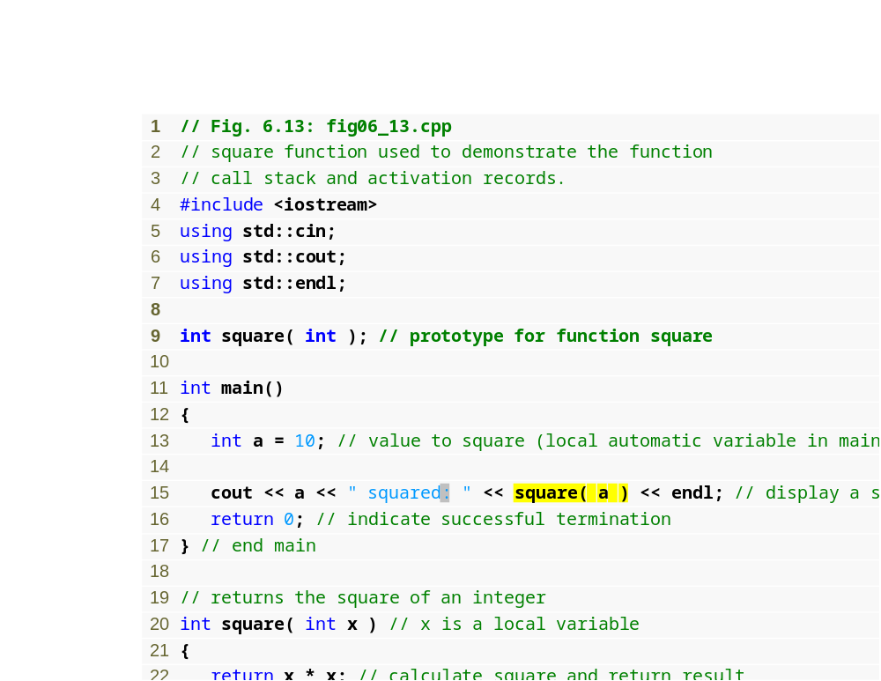
Example 7 – funcCallStack.cpp
(1 of 1)
Calling function square

Slide 66
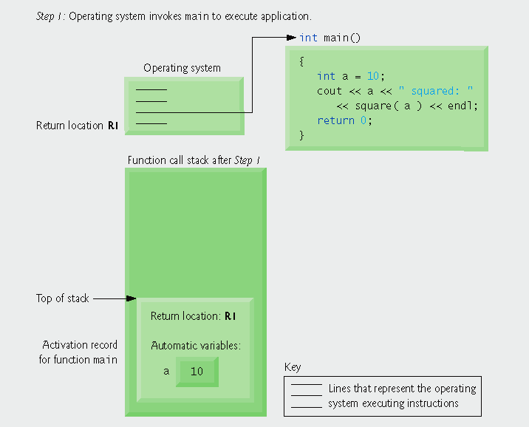
Example 7| Function call stack after the operating system invokes main to execute the application.
Operating system calls main, pushing an activation record onto the stack

Slide 67
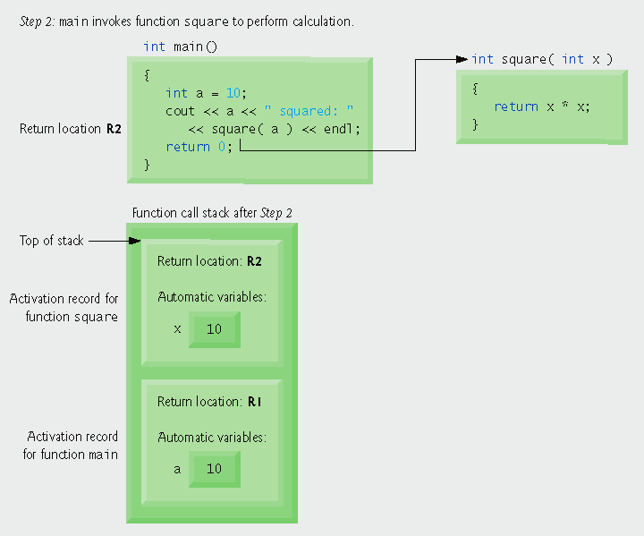
Example 7 | Function call stack after main invokes function square to perform the calculation.
main calls function square, pushing another stack frame onto the function call stack

Slide 68
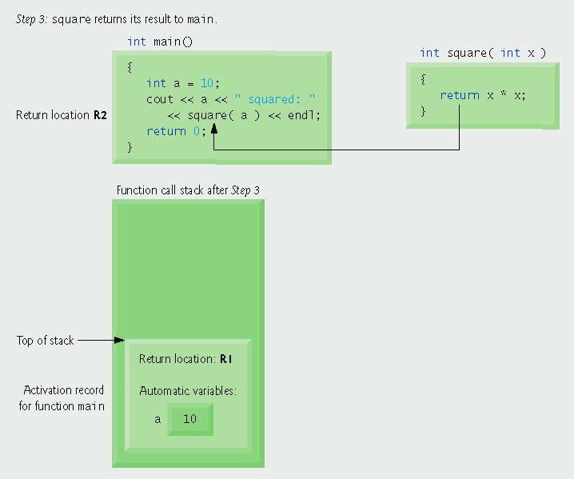
Example 7 | Function call stack after function square returns to main.
Program control returns to main and square’s stack frame is popped off

Slide 69
Default Arguments
Default arguments are passed to parameters automatically if no argument is provided in a function call
  Default arguments are usually listed in the function’s prototype
    They are literal values or constants with an = operator in front of them appearing after the data types listed in the function prototype.
    Since parameter names are optional in function prototypes they could be included for readability
  Example Prototypes that use default arguments:
    float calcArea(float = 20.0, float = 10.0);
    float calcArea(float length = 20.0, float width = 10.0);
  The default arguments are only used then the actual arguments are omitted from the function call:
    area = calcArea(); //both default values used
    area = calcArea(12.0); //12.0 passed to length, default value for width
    area = calcArea(12.0,5.5); //12.0 and 5.5 are passed
  Default Arguments need to be assigned in the earliest occurrence of the function name which is usually the prototype

Slide 70
Default Arguments
Example 8:– default.cpp
#include <iostream>
#include <cstdlib>
using namespace std;
double calcArea(double = 20.0, double = 10.0);
//overloading question - could we have a function named calcArea with zero parameters if we have this???
int main()
{
double area;
//call the function and pass no arguments, default arguments are used
area = calcArea();
cout << "When no arguments are passed to the function area = " << area << endl;
//call the function and pass one argument
area = calcArea(5.0);
cout << "When one argument is passed to the function area = " << area << endl;
//call the function and pass two arguments
area = calcArea(5.0, 1.0);
cout << "When two arguments are passed to the function area = " << area << endl;
system("PAUSE");
return 0;
}
double calcArea(double length, double width)
{
return length * width;
}

Slide 71
The conditional operator
The conditional operator takes three operands (it is C++'s only ternary operator) and its format is as follows:
  variableName = Expression1 ? Expression2 : Expression3;
The conditional operator works as follows:
  First Expression1 is evaluated
    If Expression 1 is true Expresion2 is executed
    Otherwise (else) Expression3 is executed
    Both Expression2 and Expression3 are expressions that assign values to variable
This is just a short way of writing a simple type of if-else statement
Example:
  price = age > 65 ? 10 : 20;
  If the user is over age 65 the price is 10, otherwise the price is 20
  The operator can also be used like this:
    cout << age > 65 ? 10: 20;

